Slide 1
Professional Learning
Giovanna Foschetti
Instructional Leadership Support Coordinator
January 25, 2018

Slide 2
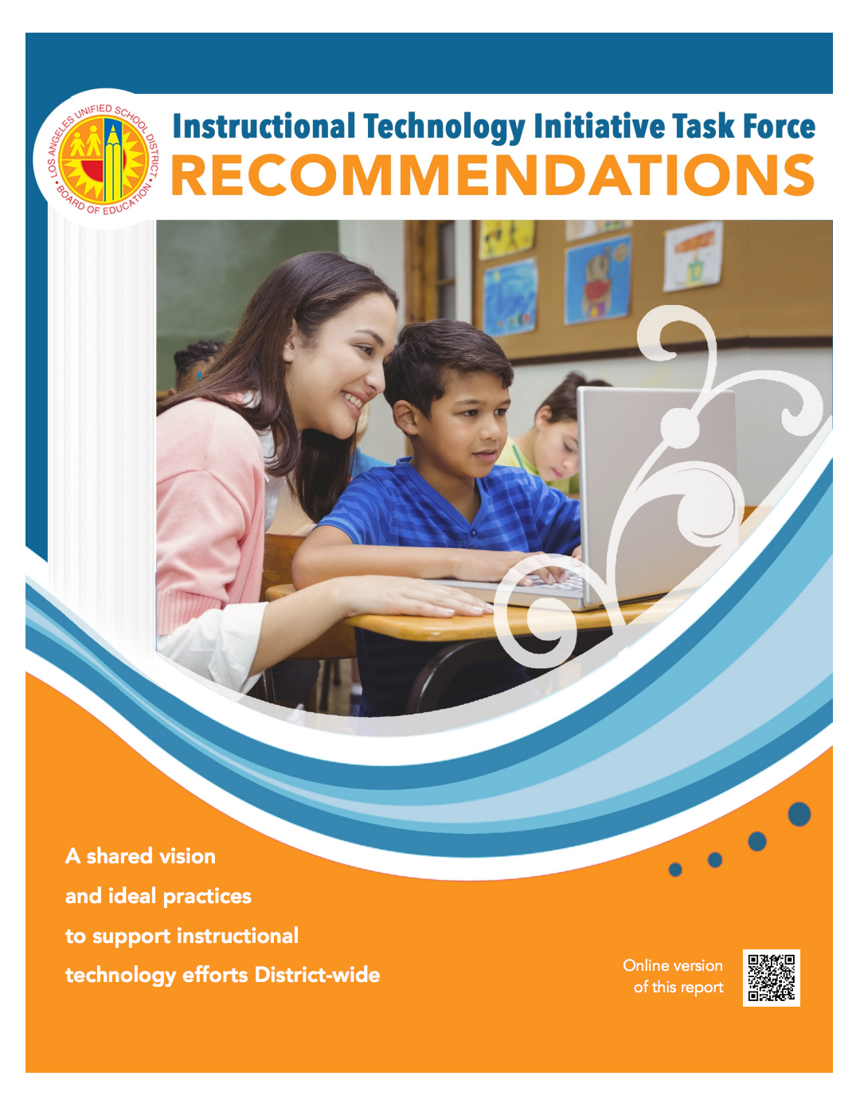
Why Professional Learning?
Recommendation 5:
Design and deliver learner-driven professional learning opportunities for school leaders, teachers, students, parents, board members, community and business leaders.

Slide 3
Pathways
Individual Professional Learning Professional learning opportunities that are open to all educators which focus on: | Team Professional Learning Professional learning opportunities that are designed for teams which focus on:
21st Century Learning Foundations ISTE Student Standard Suite Teacher Leader Network Computer Science Education | Instructional Technology Planning Cohorts Instructional Technology Planning Course Follow Up Practitioner Schools 2.0 District Level Leadership Central Leadership Local District Administrators

Slide 4
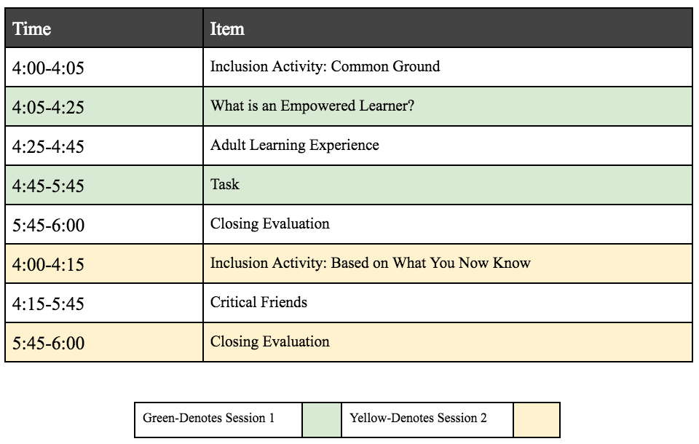
ISTE 2+1 Agenda (Individual)

Slide 5
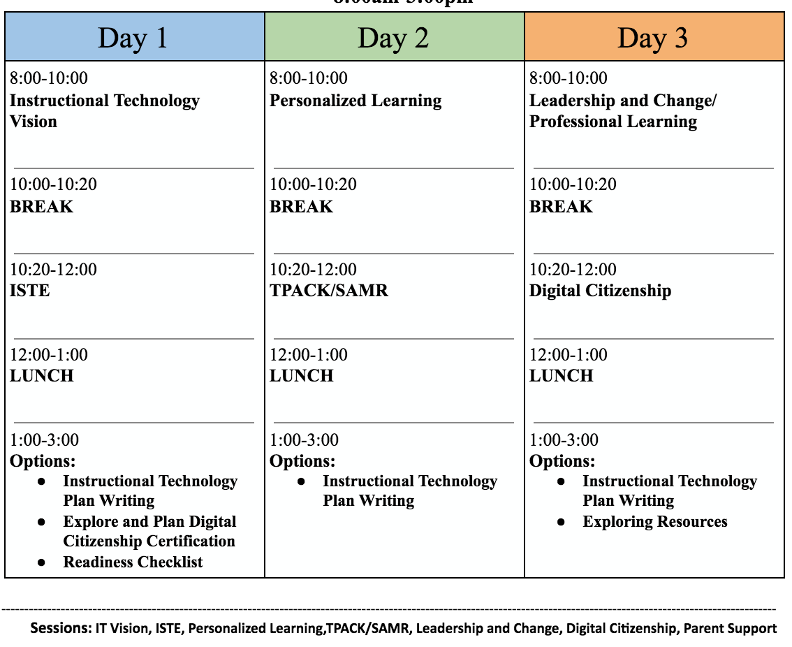
Instructional Technology Planning Cohort Agenda (Team)

Slide 6
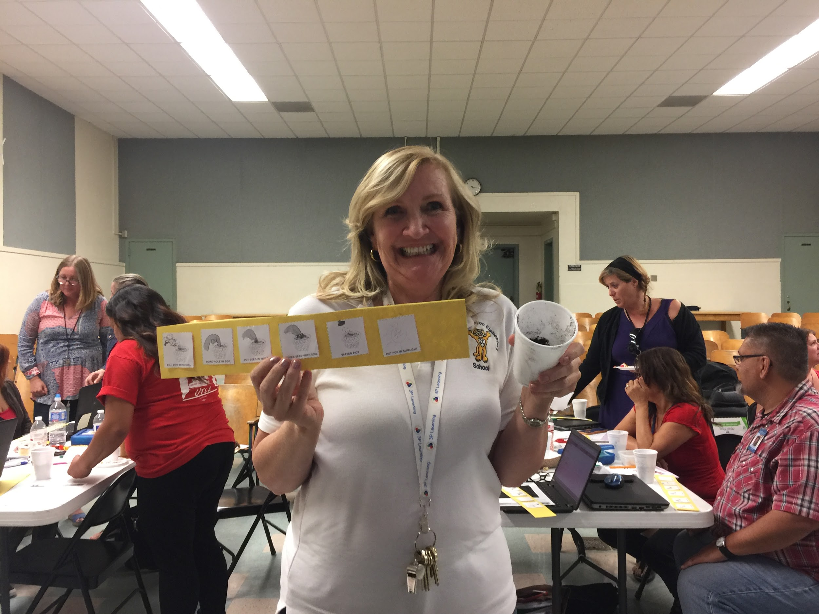
Voices from the Field
Cynthia Braley, Principal
Coldwater Canyon
Ed Tech Grant School - Practitioner 2.0 - Empowered Learner School

Slide 7
Communication Pathways
My Professional Learning Network (MyPLN)
Salary Allocations Website
ITI Monthly Newsletter
ITI Website
Local District Monthly Update
Local District Instructional Technology Specialist
Principal Organizational Meetings
Principals’ Connection
Instructional Updates
Instructional News

Slide 8
Thank You
Contact
Giovanna Foschetti
Instructional Leadership Support Coordinator
gfoschet@lausd.net
Notes:
Sophia

